Slide 1


Analysis of the connectivity of hydrides within the microstructure of Zr alloys
Research Software Engineering Practice
Group 2
Wunmi Olukoya, Jamie McGregor, Enn Veikesaar and Laura González Duque
03/06/2021
Notes:
Good morning, I’m Laura Gonzalez and I’m going to present the progress of my mini-project, called “The effect of texture on the stress and strain localisation during aluminium sheets bending”, which is being supervised by Joseph Robson and Joao Fonseca

Slide 2
Content
Image processing in Python
Determining connectivity
Testing of the code
Utilisation of git repository
Creation of functions in the code
Written report
Notes:
Aluminium alloys are among the most worldwide demanded alloys and their demand grows every year because they count on many advantageous characteristics, being the principal their low density and low price, especially of interest in the vehicle sector. The European Aluminium association estimated a 40% growth in demand for aluminium between 2019 and 2050. Aluminium sheets are the most popular way of use of this material and they are widely employed in many relevant sectors because they can be cut and formed into different desired shapes. Therefore, there is a strong incentive to optimise the performance of this product and competition in the market is very strong.

Slide 3
Image processing in Python
Notes:
Aluminium alloys are among the most worldwide demanded alloys and their demand grows every year because they count on many advantageous characteristics, being the principal their low density and low price, especially of interest in the vehicle sector. The European Aluminium association estimated a 40% growth in demand for aluminium between 2019 and 2050. Aluminium sheets are the most popular way of use of this material and they are widely employed in many relevant sectors because they can be cut and formed into different desired shapes. Therefore, there is a strong incentive to optimise the performance of this product and competition in the market is very strong.

Slide 4
Determining connectivity
Notes:
Aluminium alloys are among the most worldwide demanded alloys and their demand grows every year because they count on many advantageous characteristics, being the principal their low density and low price, especially of interest in the vehicle sector. The European Aluminium association estimated a 40% growth in demand for aluminium between 2019 and 2050. Aluminium sheets are the most popular way of use of this material and they are widely employed in many relevant sectors because they can be cut and formed into different desired shapes. Therefore, there is a strong incentive to optimise the performance of this product and competition in the market is very strong.

Slide 5
Testing of the code
Notes:
Aluminium alloys are among the most worldwide demanded alloys and their demand grows every year because they count on many advantageous characteristics, being the principal their low density and low price, especially of interest in the vehicle sector. The European Aluminium association estimated a 40% growth in demand for aluminium between 2019 and 2050. Aluminium sheets are the most popular way of use of this material and they are widely employed in many relevant sectors because they can be cut and formed into different desired shapes. Therefore, there is a strong incentive to optimise the performance of this product and competition in the market is very strong.

Slide 6
Utilisation of git repository
Notes:
Aluminium alloys are among the most worldwide demanded alloys and their demand grows every year because they count on many advantageous characteristics, being the principal their low density and low price, especially of interest in the vehicle sector. The European Aluminium association estimated a 40% growth in demand for aluminium between 2019 and 2050. Aluminium sheets are the most popular way of use of this material and they are widely employed in many relevant sectors because they can be cut and formed into different desired shapes. Therefore, there is a strong incentive to optimise the performance of this product and competition in the market is very strong.

Slide 7
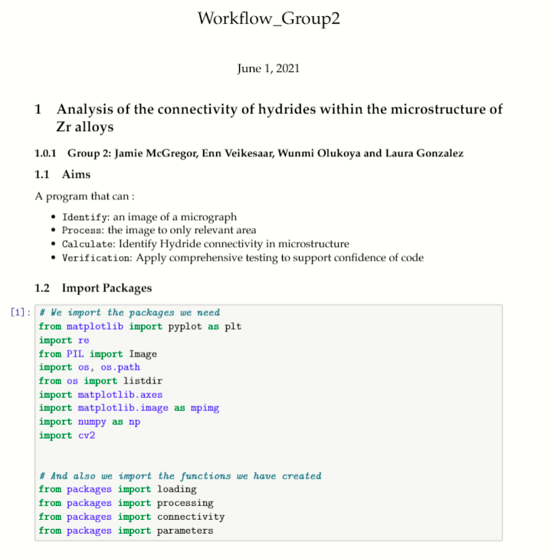
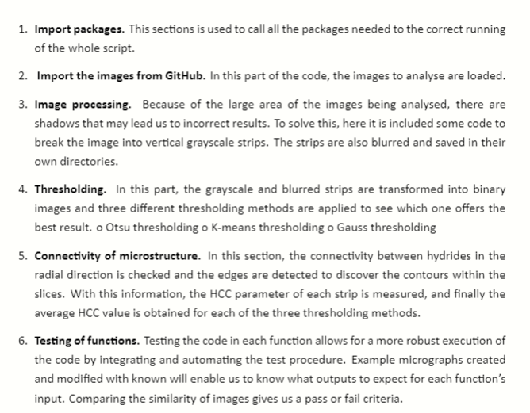
Creation of functions in the code
Structure of the demo notebook
Notes:
Aluminium alloys are among the most worldwide demanded alloys and their demand grows every year because they count on many advantageous characteristics, being the principal their low density and low price, especially of interest in the vehicle sector. The European Aluminium association estimated a 40% growth in demand for aluminium between 2019 and 2050. Aluminium sheets are the most popular way of use of this material and they are widely employed in many relevant sectors because they can be cut and formed into different desired shapes. Therefore, there is a strong incentive to optimise the performance of this product and competition in the market is very strong.

Slide 8
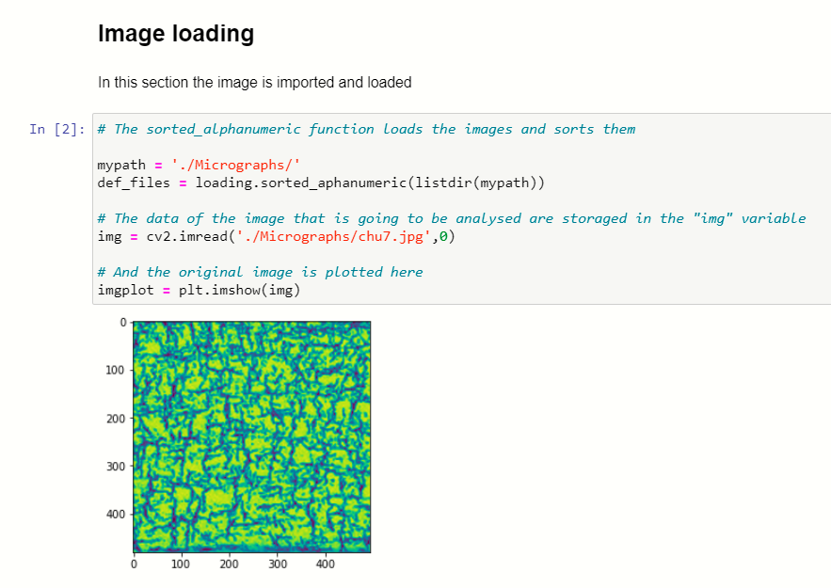
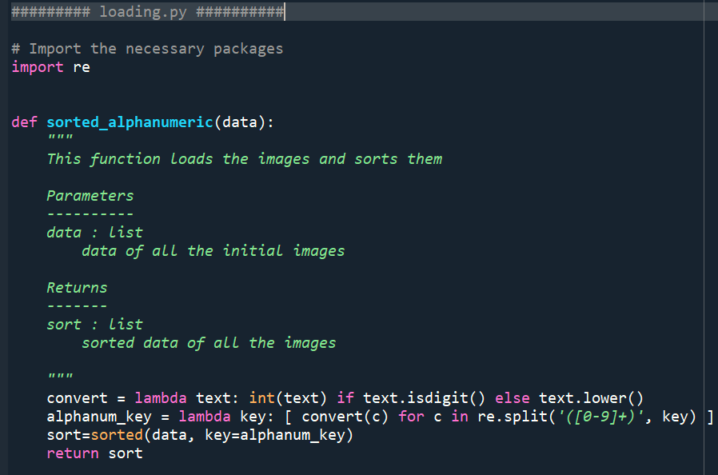
Creation of functions in the code
1
Notes:
Aluminium alloys are among the most worldwide demanded alloys and their demand grows every year because they count on many advantageous characteristics, being the principal their low density and low price, especially of interest in the vehicle sector. The European Aluminium association estimated a 40% growth in demand for aluminium between 2019 and 2050. Aluminium sheets are the most popular way of use of this material and they are widely employed in many relevant sectors because they can be cut and formed into different desired shapes. Therefore, there is a strong incentive to optimise the performance of this product and competition in the market is very strong.

Slide 9
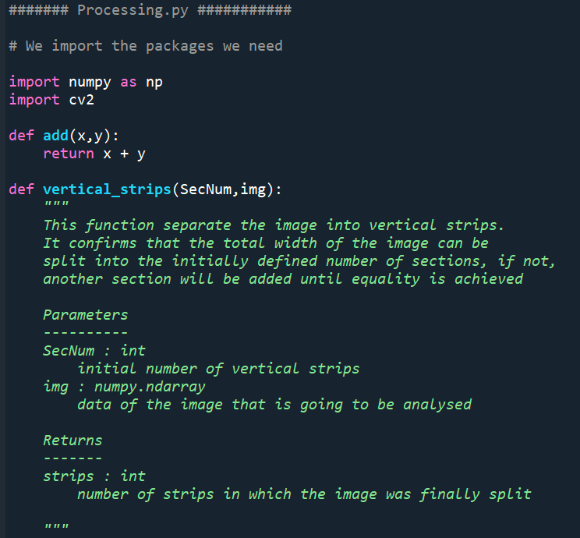
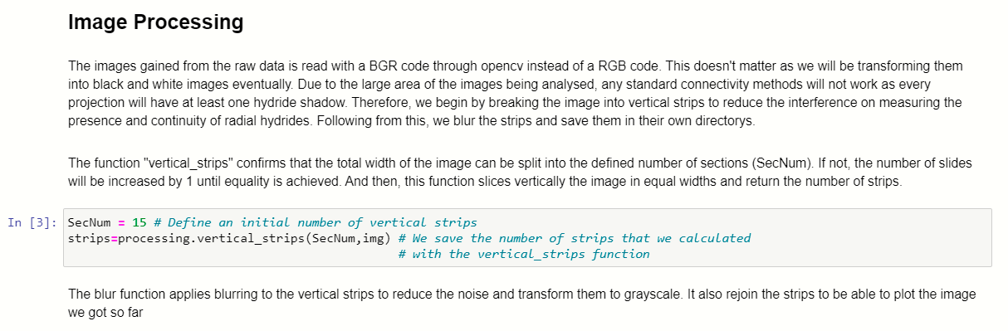
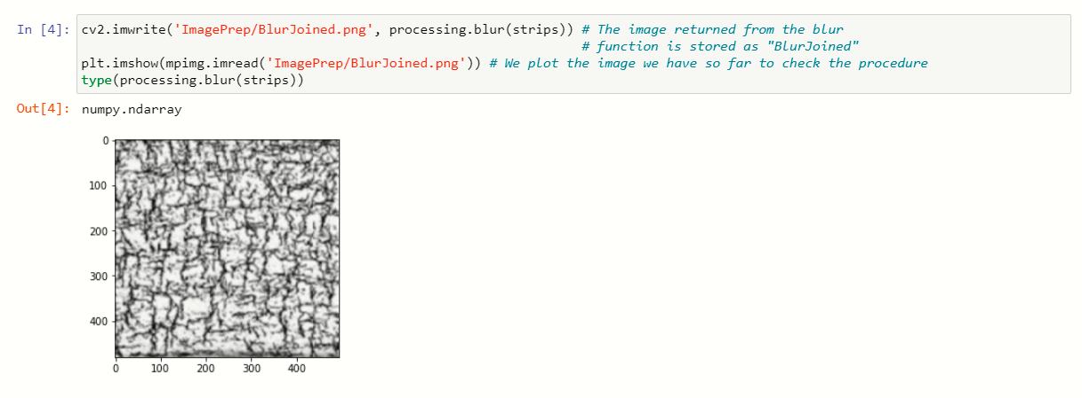
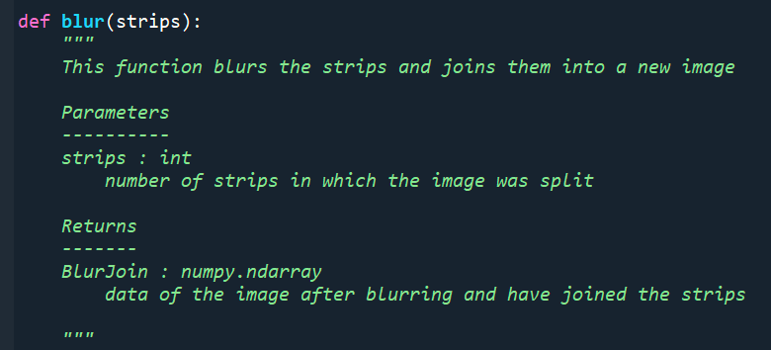
Creation of functions in the code
Notes:
Aluminium alloys are among the most worldwide demanded alloys and their demand grows every year because they count on many advantageous characteristics, being the principal their low density and low price, especially of interest in the vehicle sector. The European Aluminium association estimated a 40% growth in demand for aluminium between 2019 and 2050. Aluminium sheets are the most popular way of use of this material and they are widely employed in many relevant sectors because they can be cut and formed into different desired shapes. Therefore, there is a strong incentive to optimise the performance of this product and competition in the market is very strong.

Slide 10
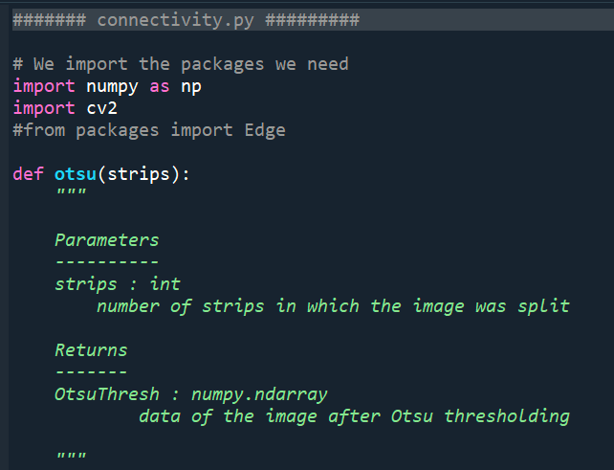
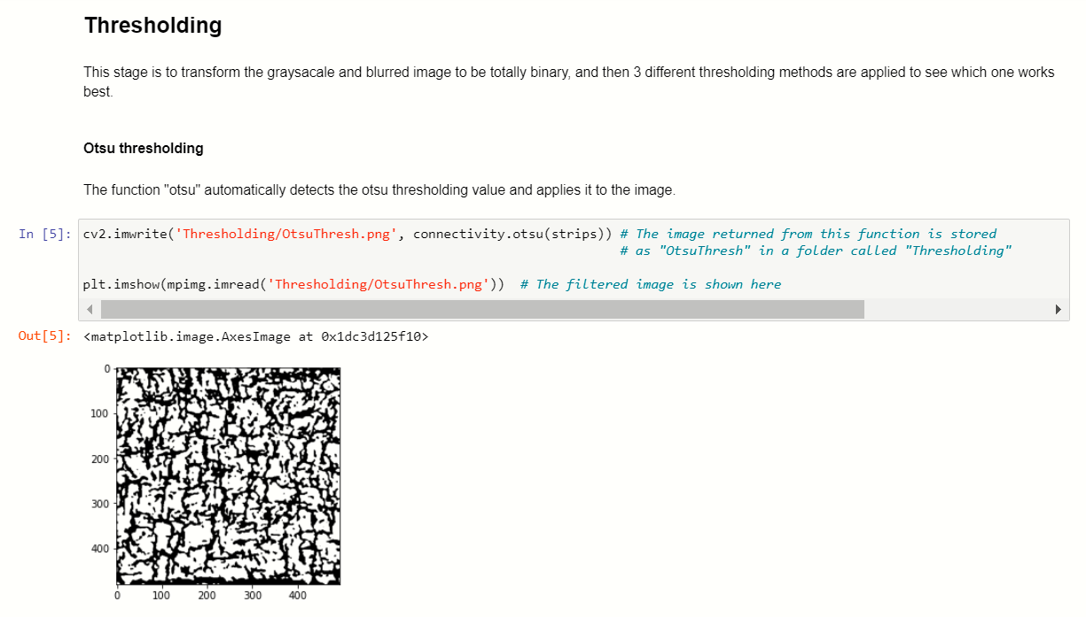
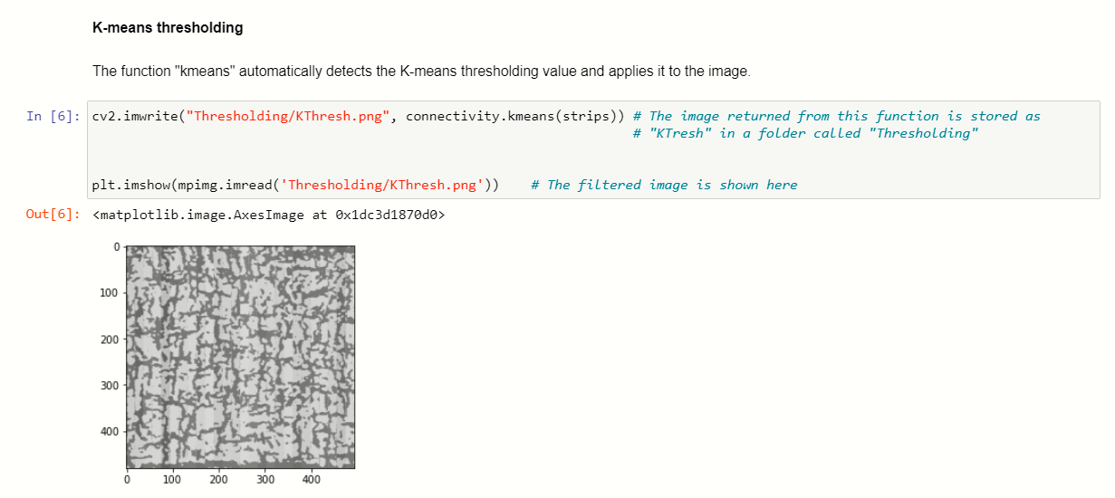
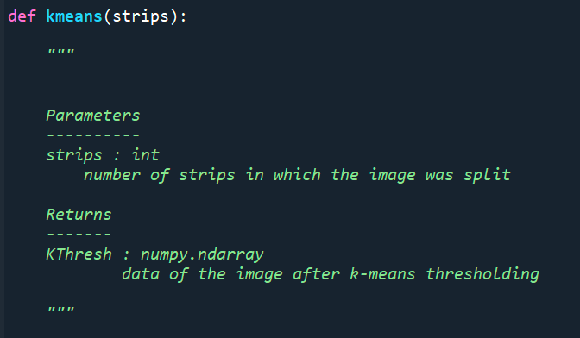
Creation of functions in the code
1
Notes:
Aluminium alloys are among the most worldwide demanded alloys and their demand grows every year because they count on many advantageous characteristics, being the principal their low density and low price, especially of interest in the vehicle sector. The European Aluminium association estimated a 40% growth in demand for aluminium between 2019 and 2050. Aluminium sheets are the most popular way of use of this material and they are widely employed in many relevant sectors because they can be cut and formed into different desired shapes. Therefore, there is a strong incentive to optimise the performance of this product and competition in the market is very strong.

Slide 11
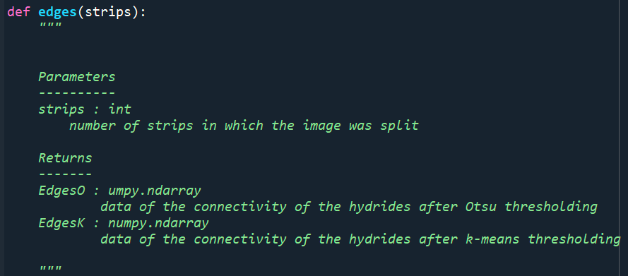
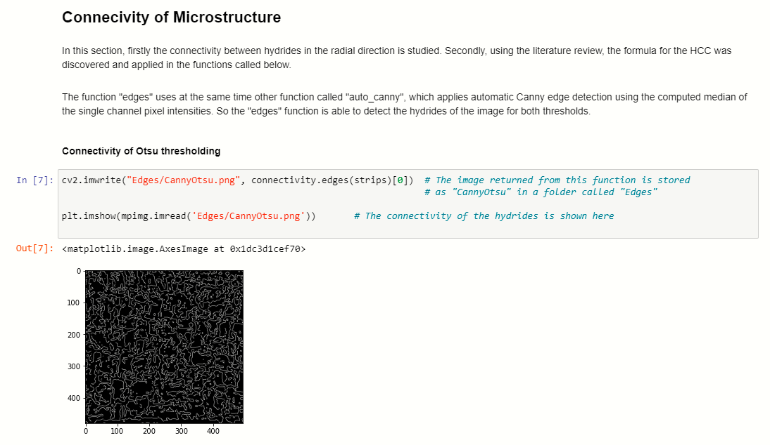
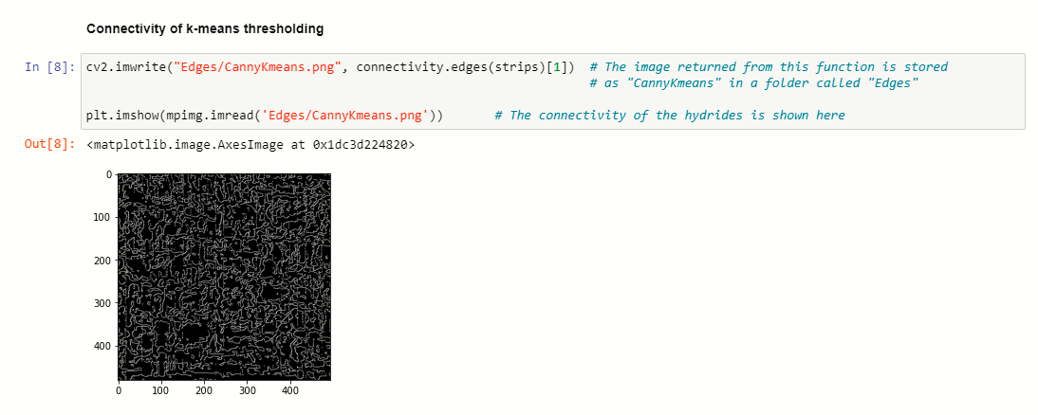
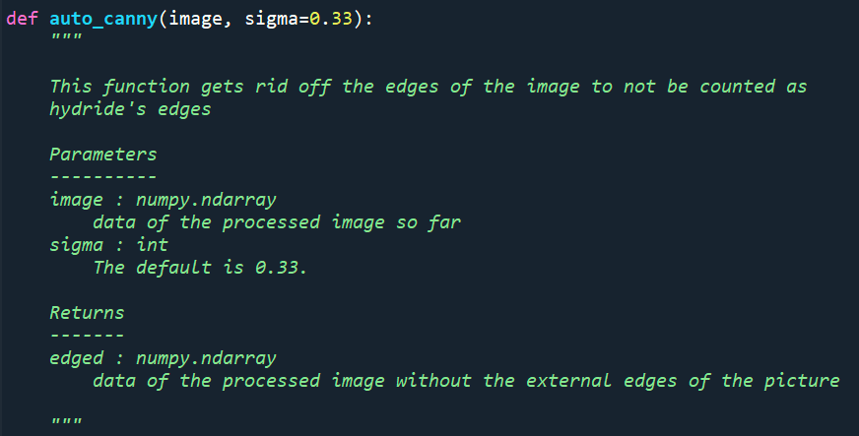
Creation of functions in the code
Notes:
Aluminium alloys are among the most worldwide demanded alloys and their demand grows every year because they count on many advantageous characteristics, being the principal their low density and low price, especially of interest in the vehicle sector. The European Aluminium association estimated a 40% growth in demand for aluminium between 2019 and 2050. Aluminium sheets are the most popular way of use of this material and they are widely employed in many relevant sectors because they can be cut and formed into different desired shapes. Therefore, there is a strong incentive to optimise the performance of this product and competition in the market is very strong.

Slide 12

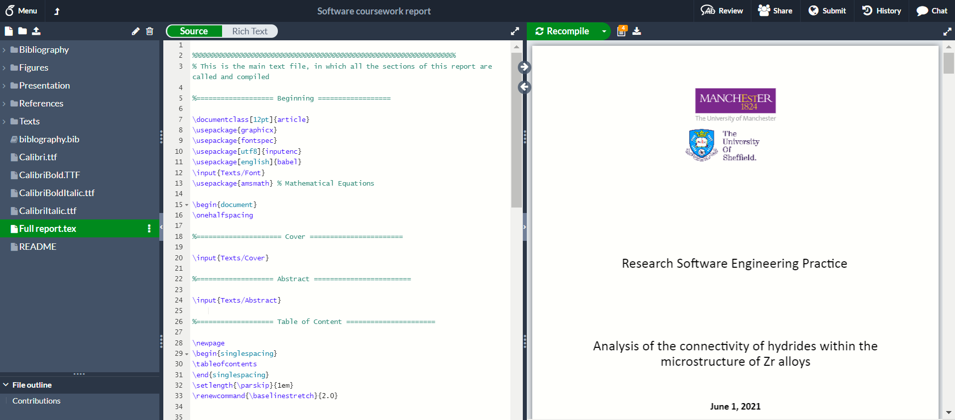
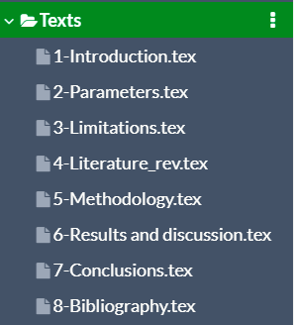
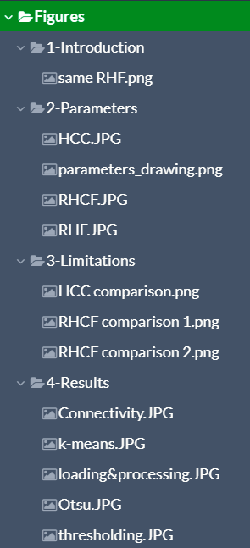
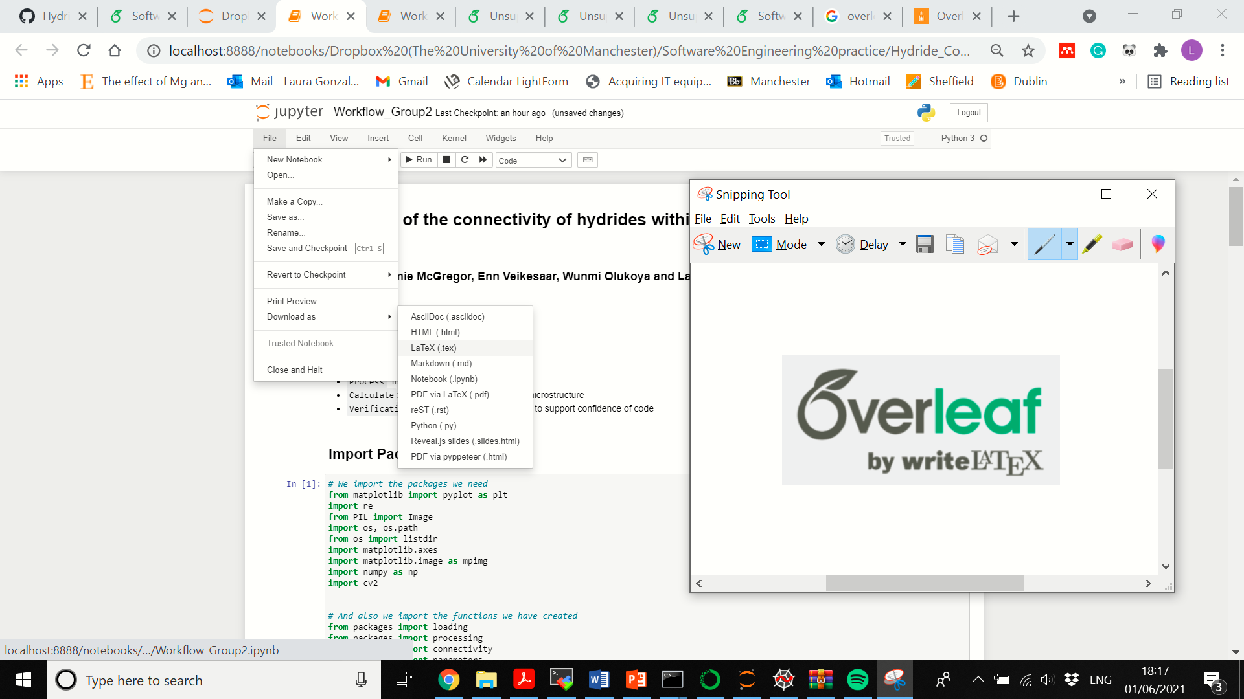
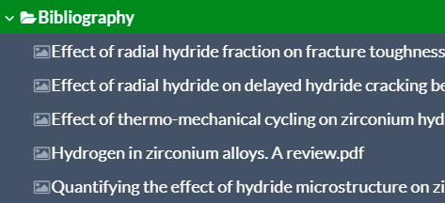
Written report
Overleaf repository for the report:
https://www.overleaf.com/project/605c7f4f07b963c175e28542
Overleaf repository for the notebook:
https://www.overleaf.com/project/60b64f4f49ce6a2fe7bf26a8
Notes:
Aluminium alloys are among the most worldwide demanded alloys and their demand grows every year because they count on many advantageous characteristics, being the principal their low density and low price, especially of interest in the vehicle sector. The European Aluminium association estimated a 40% growth in demand for aluminium between 2019 and 2050. Aluminium sheets are the most popular way of use of this material and they are widely employed in many relevant sectors because they can be cut and formed into different desired shapes. Therefore, there is a strong incentive to optimise the performance of this product and competition in the market is very strong.

Slide 13
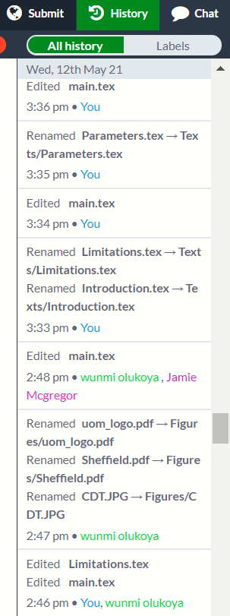
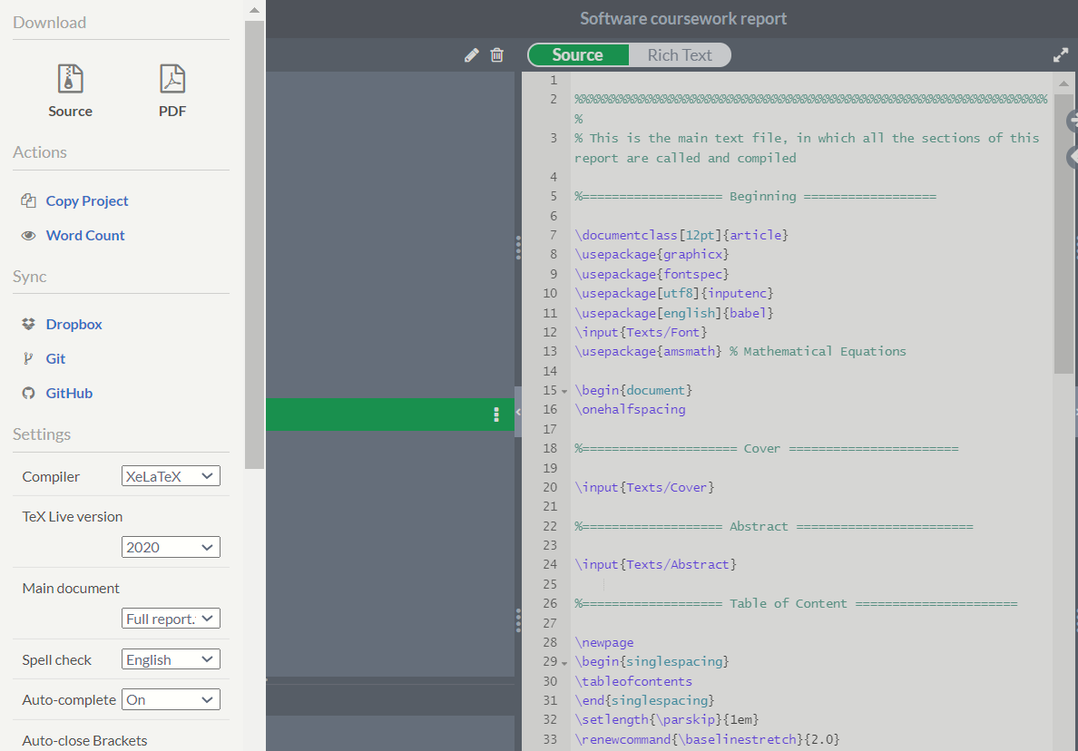

Written report
Notes:
Aluminium alloys are among the most worldwide demanded alloys and their demand grows every year because they count on many advantageous characteristics, being the principal their low density and low price, especially of interest in the vehicle sector. The European Aluminium association estimated a 40% growth in demand for aluminium between 2019 and 2050. Aluminium sheets are the most popular way of use of this material and they are widely employed in many relevant sectors because they can be cut and formed into different desired shapes. Therefore, there is a strong incentive to optimise the performance of this product and competition in the market is very strong.

Slide 14
Thank you

